Slide 1

SHARDA UNIVERSITY GREATER NOIDA
Project Based Learning
CSP 297
2023-2024 (Fourth Semester)
 | B.tech CSE section -C
Name | System ID | RollNo.
Rishabh Kushwaha | 2022448095 | 2201010575
Salman Gazi | 2022001198 | 2201010620
Mohammad Zubair | 2022366848 | 2201010414
Submitted To:
Dr. Sonia Setia
Asst. Professor
DEPARTMENT OF COMPUTER SCIENCE & ENGINEERING

Slide 2
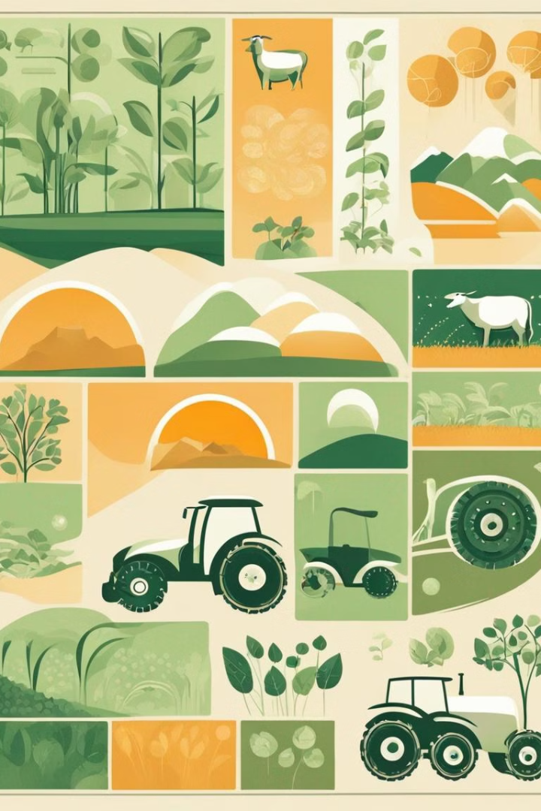
Introduction to Artificial Intelligence in Agriculture
Artificial intelligence (AI) is revolutionizing agriculture by providing innovative solutions to long-standing challenges. This interdisciplinary field integrates advanced technologies to enhance crop and livestock management.

Slide 3
Benefits of AI in Agriculture
1
Enhanced Efficiency
Sustainable Practices
2
AI optimizes agricultural processes, increasing productivity and resource management.
AI facilitates environmentally conscious farming practices, reducing waste and minimizing environmental impact.
3
Precise Decision-Making
4
Improved Yield
AI-driven insights enable precise and data-driven decision-making for better agricultural outcomes.
AI contributes to higher yields through predictive and preventive measures for crop and livestock management.

Slide 4
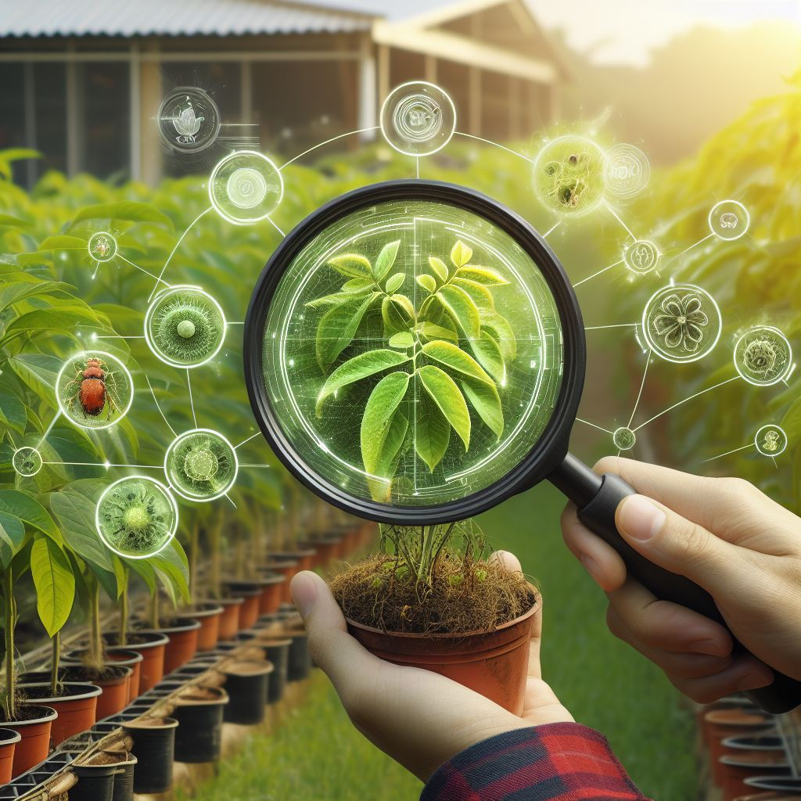
Applications of AI in Leaf Disease Detection
Leaf disease detection is a critical issue for farmers and agriculturalists. The detection of leaf diseases at an early stage can help prevent the spread of diseases and ensure a better yield. However, manual detection of leaf diseases is time-consuming and often inaccurate. With the advancement of technology, machine learning, and computer vision techniques can be used to develop automated solutions for leaf disease detection.

Slide 5
Technology Used :
Html ,CSS for Frontend
Python for Backend
Tensorflow ,Keras For Model Training
The Deep learning Model
The Leaf Disease Detection Flask App uses a deep learning model to detect the presence of leaf diseases. The model is trained on a dataset of images of healthy and diseased leaves. The model uses a convolutional neural network (CNN) to extract features from the images and classify them as healthy or diseased.
The deep learning model is implemented using Keras, a high-level neural networks API written in Python. Keras provides a simple and intuitive interface for building and training deep learning models.

Slide 6
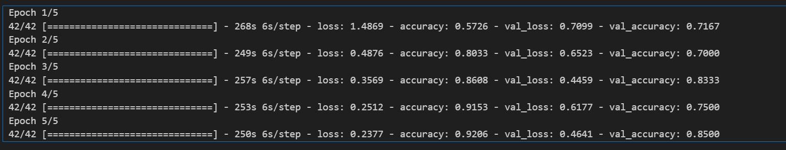
Model Training Result

Slide 7
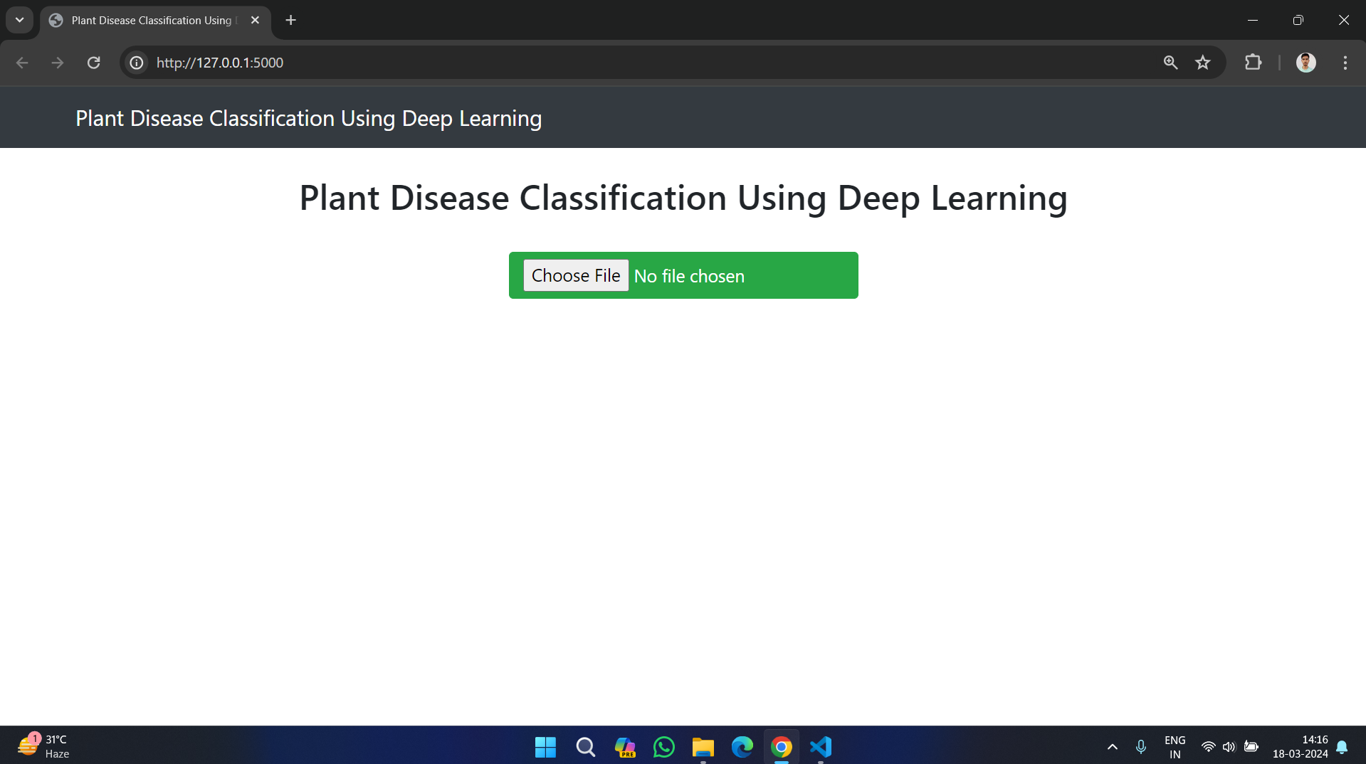
Leaf Disease Detection Web Application
Main Screen

Slide 8
Web Interface:
The web interface allows users to upload images of leaves and receive predictions on whether the leaves are healthy or diseased. The interface is built using HTML, CSS. The interface includes a file upload button that allows users to select an image to upload.
Prediction Engine:
The prediction engine is responsible for processing the uploaded image and making a prediction on whether the leaves are healthy or diseased. The prediction engine uses the deep learning model to make predictions on the uploaded image.
The prediction engine is built using Flask and Keras. The Flask application receives the uploaded image and passes it to the prediction engine. The prediction engine processes the image using the deep learning model and returns a prediction to the Flask application. The Flask application then displays the prediction to the user.

Slide 9
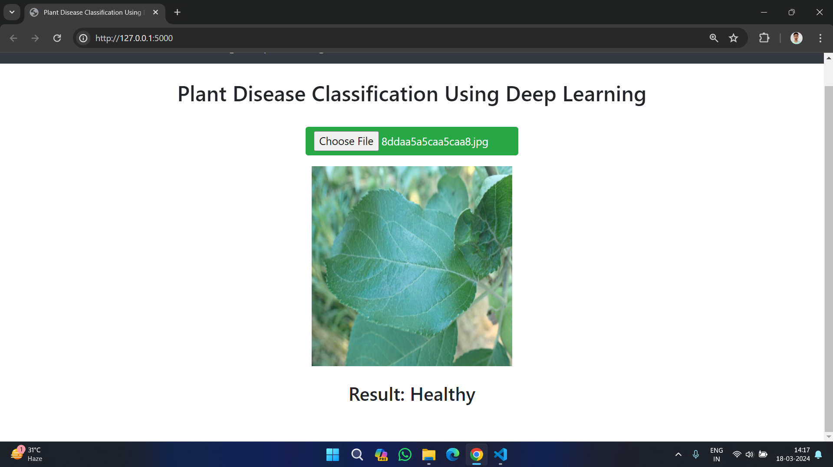
Result Screen

Slide 10
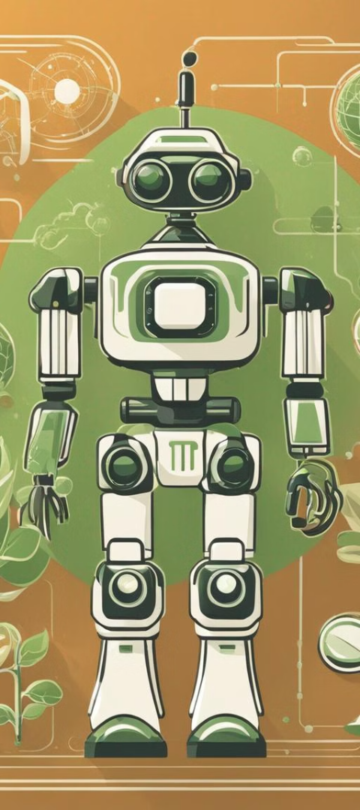
Conclusion
The Leaf Disease Detection Flask App provides an automated solution for the detection of leaf diseases. The app uses a deep learning model to make predictions on whether the leaves are healthy or diseased. The app is built using Flask, a lightweight web application framework, and Keras, a high-level neural networks API. The app provides a simple and intuitive interface for users to upload images of leaves and receive predictions on whether the leaves are healthy or diseased.
The Leaf Disease Detection Flask App has the potential to improve the efficiency of leaf disease detection and improve crop yields for farmers and agriculturalists. With further development, the app can be expanded to include more types of leaf diseases and additional features to provide more comprehensive information on leaf health.

Slide 11
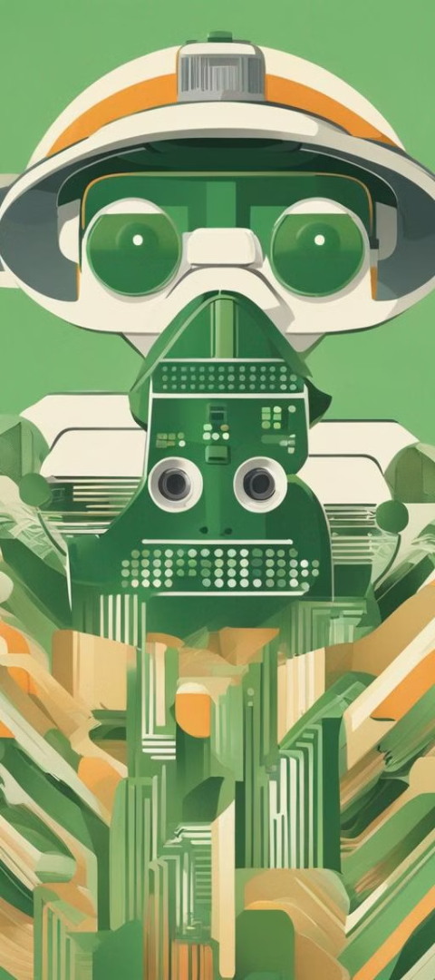
Name :- Rishabh Kushwaha
System Id :- 2022448095
Name :- Salman Gazi
System id :- 2022001198
Name :- Mohammad Zubair
System id :- 2022366848

